Slide 1

Understanding the Manufacturing Sales Tax Exemption
James Costigan, Tax Auditor Agent
Dara Greene, Attorney, Tax Appeals Division

Slide 2
Agenda
I. Manufacturing Exemption Overview
II. Manufacturing Operation
III. Items that Qualify for the Exemption
IV. Items that Do Not Qualify for the Exemption
V. Percentages of Taxability
VI. Services and Software Related to Manufacturing
VII. Research and Development
VIII. Miscellaneous

Slide 3
Manufacturing Exemption Overview

Slide 4

What is the Manufacturing Exemption?
It is a statutory exemption from sales tax laid out in 5739.02 (B)(42)(g) for specific items used in a manufacturing process, as described in O.R.C. 5739.011

Slide 5

Who Qualifies?
Manufacturer is defined as “a person who is engaged in manufacturing, processing, assembling or refining a product for sale and, solely for the purposes of division (B)(12) of this section, a person who meets all of the qualifications of that division.”

Slide 6
Who Qualifies?
Refining is defined in the Revised Code as removing or separating a desirable product from raw or contaminated materials by distillation or physical, mechanical, or chemical processes.
Assembly and assembling is defined in the Revised Code as attaching or fitting together parts to form a product, but do not include a packaging product.

Slide 7
Who Qualifies?
A manufacturer must be changing the state or form of a material in order to sell it
Completing repairs of TPP owned by another party does not qualify

Slide 8

Who Qualifies?
Per Ohio Administrative Code 5703-9-14 (F)(1), a taxpayer that operates as both a manufacturer and a contractor must elect to be treated as one or the other on the purchase of raw materials
Example: Window manufacturer that also completes installation

Slide 9
Purchasing Qualifying Items Exempt
Provide vendor an exemption certificate for items qualifying for the exemption
The reason for exemption would be “Use in manufacturing”

Slide 10
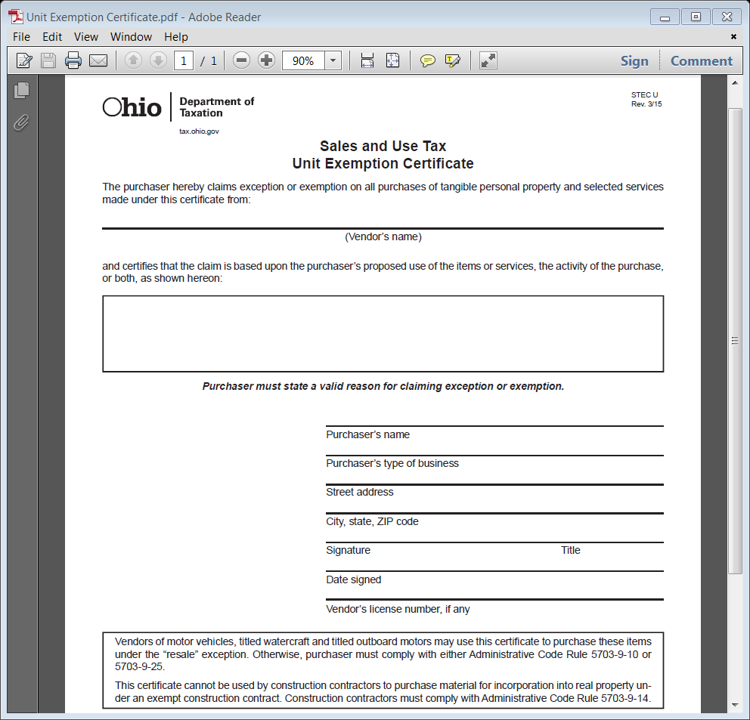

Slide 11
Purchasing Qualifying Items Exempt
This is not a blanket exemption for materials used in all aspects of a manufacturer’s business
Only items directly involved in the manufacturing process will qualify for exemption
Some vendors will sell items used both in and outside the manufacturing process.

Slide 12
Manufacturing Operation

Slide 13
Manufacturing Operation
This is defined in O.A.C. 5703-9-21 as “a process in which materials are changed, converted, or transformed into a different state or form from which they previously existed and includes refining materials, assembling parts, and preparing raw materials and parts by mixing, measuring, blending or otherwise committing such materials or parts to the manufacturing process.”

Slide 14
Beginning of the Manufacturing Operation
Raw materials are committed to the manufacturing process when any of the following occur.
Where materials handling from initial storage has ceased
Where materials handling from the place of receipt ceases (w/o initial storage)
Where materials have been mixed, measured, blended, heated, cleaned, or otherwise treated or prepared for the manufacturing process
Different materials can have different points of commitment

Slide 15
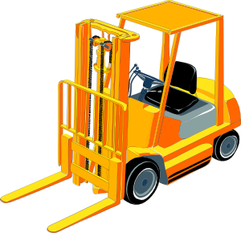
Beginning of the Manufacturing Process
Materials handling is defined in the Revised Code as the movement of the product being or to be manufactured, during which movement the product is not undergoing any substantial change or alteration in its state or form.

Slide 16
End of the Manufacturing Operation
The manufacturing operation has ended when the item being manufactured will have no further alterations to it and is considered to be a competed product (or finished good).

Slide 17
End of the Manufacturing Operation
Completed product is defined in the Revised Code as a manufactured item that is in the form and condition as it will be sold by the manufacturer.

Slide 18

End of the Manufacturing Operation
Packaging does not qualify for the manufacturing exemption, however, a specific packaging exemption exists under O.R.C. 5739.02 (B)(15)

Slide 19
Manufacturing Operation - Summary
Exemption for manufacturing exists for items that have specific and direct interactions with the good in process between the beginning and the end of the manufacturing operation

Slide 20
Items that Qualify for Exemption

Slide 21
Items that Qualify for Exemption
Items that qualify for the manufacturing exemption include but are not limited to the following
Production machinery and equipment that act upon the product
Also included are parts, components, and repair and installation services for such equipment

Slide 22

Items that Qualify for Exemption
Materials Handling Equipment
Examples include forklifts, conveyors, pressurized piping, etc.
Fuel for such piping is also exempt

Slide 23
Items that Qualify for Exemption
Catalysts, solvents, water, acids, oil, and similar consumables

Slide 24
Items that Qualify for Exemption – Consumables Example
Example: A steel fabricator purchases coil steel. After the steel is committed to the manufacturing operation, it is dipped in solvent to remove dirt, oil, and grease. It is then further cleaned by dipping in an acid bath. After fabrication is completed, the steel is sprayed with oil to prevent formation of rust on the surface of the product. After the oil spray, the steel is transported to the truck dock for loading and shipping.

Slide 25
Items that Qualify for Exemption – Consumables Example
Test Your Knowledge:
In the preceding example, what would be the taxability of the solvent and acid used to clean the steel?
At what point would the manufacturing process be considered complete?
What would be the tax status of the oil that is added to the steel?

Slide 26
Items that Qualify for Exemption – Consumables Example
Answers:
The solvent and acid are consumables used to prepare the product during the manufacturing operation and are not taxable.
The spraying of the protective oil on the completed product constitutes the end of the manufacturing operation.
The oil is a consumable which interacts with the product and is therefore not taxable.

Slide 27
Items that Qualify for Exemption
Machinery, equipment, and other tangible personal property used during the manufacturing operation that control, physically support, produce power for, lubricate, or are otherwise necessary for the functioning of production machinery and equipment and the continuation of the manufacturing operation

Slide 28
Items that Qualify for Exemption – Control and Support Example
Example: The functioning of the melt furnace in a glass manufacturing facility is monitored and controlled from an operator's booth, which is on a raised platform about fifty feet from the furnace. Heat sensors in the furnace are wired to the control booth, where the temperature data is drawn on a continuous graph. The operator watches the graph and can adjust the furnace by altering the flow of fuel (natural gas) or oxygen, batch material proportions, or by adjusting the flue in the furnace stack.

Slide 29
Items that Qualify for Exemption – Control and Support Example
Test Your Knowledge:
What would be the taxability of the sensors in the furnace?
Do the control booth and equipment within qualify for exemption?
What is the tax status of the temperature graphing device?
Does the platform supporting the control booth qualify for exemption?

Slide 30
Items that Qualify for Exemption – Control and Support Example
Answers:
The sensors in the furnace monitor production and are not taxable.
The control booth and the equipment and controls in it are not taxable.
The temperature graphing device which records the temperature data is taxable since it functions as a recordkeeping device.
The platform that supports the control booth is not taxable, since it supports the operator of production machinery.

Slide 31
Items that Qualify for Exemption
Machinery, equipment, fuel, power, material, parts, and other tangible personal property used to manufacture machinery, equipment, or other tangible personal property used in manufacturing a product for sale

Slide 32
Items that Qualify for Exemption
Equipment directly used in testing any of the following:
1. Raw Materials
2. The product being manufactured
3. The completed product

Slide 33
Items that Qualify for Exemption
Testing is defined in the Revised Code as a process or procedure to identify the properties or assure the quality of a material or product.
In order to qualify, the item in question must have direct involvement in completing the test.

Slide 34
Items that Qualify for Exemption
Machinery and equipment used to handle or temporarily store scrap that is intended to be reused in the manufacturing operation at the same manufacturing facility
Any source of fuel or power for machinery used in the manufacturing operation
Any equipment used by the manufacturer to generate such fuel or power is also exempt

Slide 35
Items that Do NOT Qualify for Exemption

Slide 36
Items that Do NOT Qualify for Exemption
Items that Do NOT qualify for the manufacturing exemption include but are not limited to the following
Tangible goods used in administrative, inventory control, or similar functions
Storage of raw materials prior to commitment to the manufacturing operation

Slide 37
Items that Do NOT Qualify for Exemption
Equipment used for materials handling of raw materials prior to commitment to the manufacturing operation
Equipment used for materials handling of finished goods
Storage of finished goods
Storage of process consumables

Slide 38
Items that Do NOT Qualify for Exemption
Machinery, equipment and other tangible property used for ventilation, dust or gas collection, humidity or temperature regulation, or similar environmental control
Exception would be if it totally regulates the environment in a special and limited area necessary for production to occur
a) Clean room
b) Paint booth

Slide 39

Items that Do NOT Qualify for Exemption
Tangible Personal Property used for protection or safety of workers
Exception would be if the property were attached or incorporated into machinery and equipment used in the manufacturing operation

Slide 40

Items that Do NOT Qualify for Exemption
Motor vehicles registered for operation on public highways
Vehicles moving goods between manufacturing facilities prior to Work in Process becoming finished goods would not qualify.

Slide 41

Percentages of Taxability
Items used within the manufacturing process can be used in both a taxable and exempt manner
Primary use for machinery
Treatment of fungibles
Items for which use is difficult to determine

Slide 42
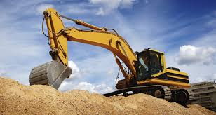
Percentages of Taxability
R.C. 5739.011(D)
A machine that is used by a manufacturer in both a taxable and exempt manner is treated as either totally taxable or totally exempt based upon its quantified primary use
Examples from O.A.C. 5703-9-21
Boilers
Lift Trucks
Refrigeration system

Slide 43
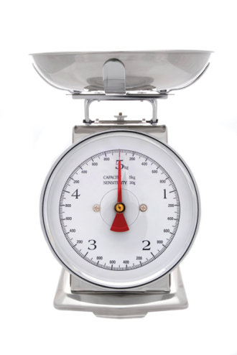

Percentages of Taxability
AeroQuip Corp. v. Tracy, B.T.A. No. 97-T-1612 (2000)
AeroQuip Corp. v. Tracy, B.T.A. No. 2000-S-161 (2002)
“Quantified” can be any measurement of use
Time of use
Amounts processed
Will vary according to item

Slide 44
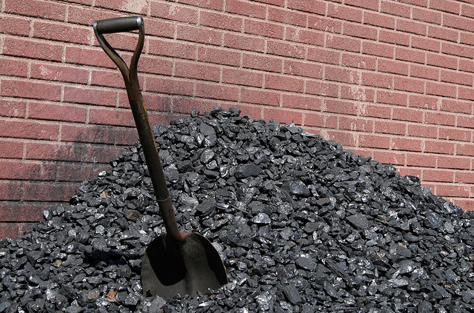
Percentages of Taxability
R.C. 5739.011(D)
Fungibles that are used in both a taxable and exempt manner shall be taxed upon the proportion of the fungibles used in a taxable manner
Percentage of taxability
determined by study completed
by ODT and taxpayer

Slide 45
Percentages of Taxability
B.F. Goodrich Co. v. Lindley, 58 Ohio St.2d 364 (1979)
Coal and fuel used to power manufacturing equipment and heat buildings
Primary use test cannot be used to escape payment of tax by failing to separate fungibles

Slide 46

Percentages of Taxability
Natural Gas
Propane for forklifts
Small parts and tools

Slide 47


Services & Software
Employment Services
Building Maintenance & Janitorial Services
Computer Services &
Software

Slide 48
Employment Services
R.C. 5739.01(B)(3)(k) & (JJ)
supplying personnel, (temporary or long-term)
to perform work under another's supervision or control
personnel receive their compensation from the provider of the employment service

Slide 49

Employment Services
R.C. 5739.01(JJ)(3)
Contract of at least one year
Contract specifies that each employee is assigned “permanently”

Slide 50
Employment Services
H.R. Options v. Zaino, 100 Ohio St.3d 373 (2004)
Permanent = Indefinite Period
No ending date
Not a substitute for employee
Not short term work
“The contract, along with the facts and circumstances of the assignment, should permit the Tax Commissioner’s agent to determine permanency.”

Slide 51

Employment Services
Bellemar Parts Industries, Inc. v. Tracy, 88 Ohio St.3d 351 (2000)
Rejected resale exemption
Employment services are not a “thing transferred”
Specific services are listed per R.C. 5739.02(B)(42)

Slide 52

Building Maintenance & Janitorial
R.C. 5739.01(B)(3)(j)
Providing building maintenance and
janitorial services is defined as a
taxable sale
R.C. 5739.01(II)
Cleaning the interior or exterior of
a building and any tangible personal property therein
- less than $5,000
- establishment described in 21 U.S.C. 608

Slide 53
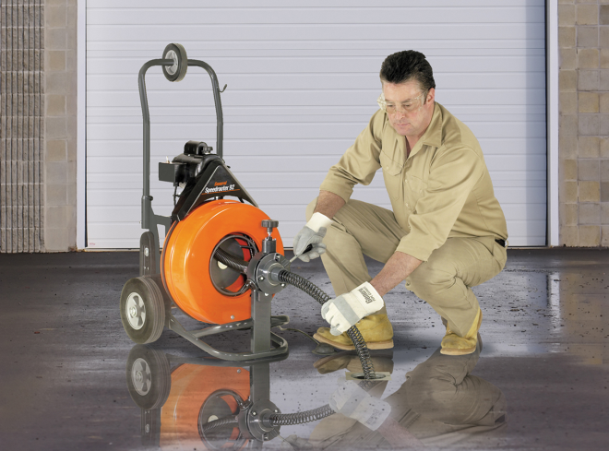
Building Maintenance & Janitorial
R.C. 5739.011(C)(8)
The “thing transferred” does not include machinery used to clean, repair or maintain real or personal property in the facility
Except as provided in R.C. 5739.011(B)(13)

Slide 54
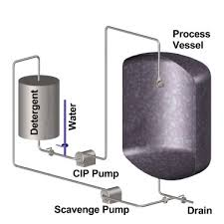
Building Maintenance & Janitorial
Clean-in-Place Systems
Do not qualify for the manufacturing exemption unless you are producing:
milk
ice cream
yogurt
cheese

Slide 55
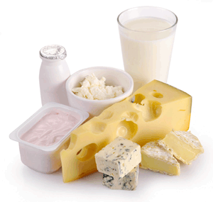
Building Maintenance & Janitorial
The Dannon Company, Inc. v. Tracy, B.T.A. No. 97-M-233 (1998)
Distinction between cleaning and necessary for the manufacturing process
Limited to certain yogurt production, but R.C. 5739.011(B)(13) exempts all dairy cleaning equipment

Slide 56
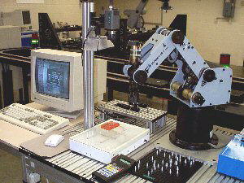
Computer Services & Software
Minco Tool & Mold, Inc. v. Limbach, B.T.A. No. 88-E-157 (1990)
Software that was used to control production machinery based upon CAD-CAM drawings qualified for the manufacturing exemption

Slide 57
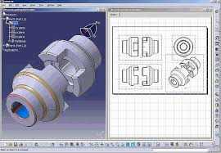
Computer Services & Software
Software that would not qualify for the exemption:
Monitoring Software
Product Design Software
Inventory Software

Slide 58

Research & Development
R.C. 5739.02(B)(42)(i)
Exempts purchases where the purpose is to use the “thing transferred” as qualified research and development equipment
Not limited to manufacturers

Slide 59

Research & Development
R.C. 5739.01(GG)
Research and development
Designing, creating new products, equipment or manufacturing processes
Conducting scientific experiments to increase scientific knowledge that might reveal new products, equipment or manufacturing processes

Slide 60
Research & Development
R.C. 5739.01(HH)
Qualified Research and Development Equipment
Capitalized tangible personal property
Used to conduct research and development

Slide 61
Research & Development
Testing R&D
Limited to manufacturers Not limited
Tangible personal property Capitalized items only
Raw materials, in-process New products or product, or completed processes and
product experiments

Slide 62
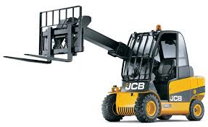

Miscellaneous
Q3 Stamped Metal, Inc. v. Zaino, 92 Ohio St.3d 493 (2001)
“Otherwise necessary for the functioning of production machinery and equipment and the continuation of the manufacturing operation.”

Slide 63

Miscellaneous
R.C. 5739.031
Direct Payment Authority
Procedural Agreements Review

Slide 64
Contact Information
James Costigan
(614) 466-8099
James.Costigan@tax.state.oh.us
Dara Greene
(614)466-6750
Dara.Greene@tax.state.oh.us

